Slide 1

Sensors and Automation (Interdisciplinary Foundation Course–II) Theory Session
COEP Tech., Pune

Slide 2
Course Contents: S&A
Course Name: Sensors and Automation
(Interdisciplinary Foundation Course–II)
Teaching Scheme Examination Scheme
Lectures: 1 Hr / Week Assignment/Quizzes : 40 marks
Practicals: 2 Hrs / Week End Semester Exam : 60 marks
Unit No | Contents
1 | Basics of Sensors: Concepts and terminology of transducer, sensor, sensor classifications and characteristics (Static and dynamic), Working principle, characterization and applications of: strain gauges, LVDT, capacitive, RTD, thermocouple, thermistor, Solid-State, pressure, optical, chemical sensors, integration of sensors for IOT and Industry 4.0 applications.
2 | Industrial Automation Industrial Automation: concept, automation components, necessity and working principle, block schematic of Programmable Logic Controller (PLC). Input & Output modules (AI, DI, AO, DO), Introduction to Ladder Programming, introduction to Distributed Control Systems (DCS). Industrial automation leads to Industrial IOT and Industry 4.0.

Slide 3
Applications of Sensors and Automation

Slide 4
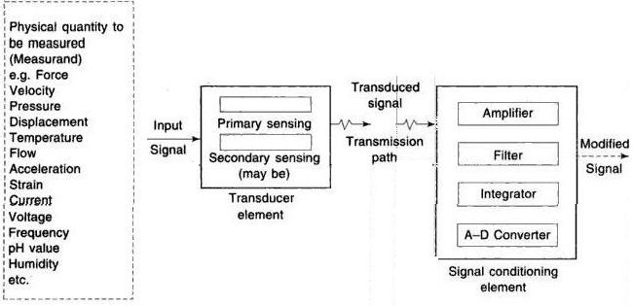
Generalized Measurement System

Slide 5
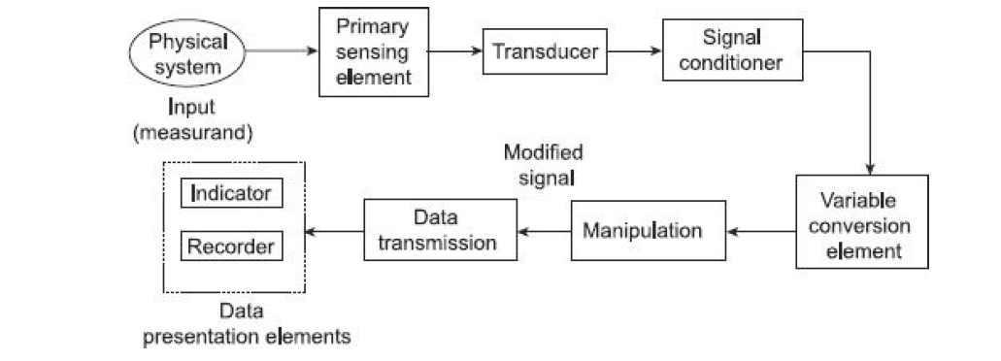

Slide 6
Generalized Measurement System: Applications
Measurement of system parameters information
Control of a certain process operation
Simulation of system conditions
Experimental design studies
To perform various manipulations
Testing of materials, maintenance of standards and specifications
Verifications of physical phenomenal scientific theories
Quality control in industry

Slide 7
Physical System: The physical system refers to the real-world entity or phenomenon that we want to measure. It could be any measurable quantity such as temperature, pressure, length, or voltage.
Primary Sensing Element: The primary sensing element is the component that directly interacts with the physical system to sense or detect the input quantity. It could be a sensor, detector, or any other device designed to convert the physical parameter into a measurable signal.
Transducer: A transducer is a device that converts one form of energy into another. In the context of a measurement system, a transducer is often used to convert the physical quantity being measured into a corresponding electrical signal. For example, in a temperature measurement system, a thermocouple or an RTD (resistance temperature detector) can act as a transducer by converting the temperature into an electrical voltage.
Signal Conditioner: The signal conditioner is responsible for modifying or conditioning the raw electrical signal from the transducer to make it suitable for accurate measurement. This may involve amplification, filtering, linearization, or other operations to improve the quality and reliability of the signal.
Variable Conversion Element: The variable conversion element is used when there is a need to convert the measured quantity from one form to another. For instance, if the measurement is in electrical voltage and needs to be converted to a different unit or physical quantity, such as temperature, the variable conversion element performs the necessary conversion.
Manipulation: Manipulation refers to any additional processing or manipulation of the measured data to extract useful information or perform specific calculations. This can include mathematical operations, data filtering, averaging, or any other relevant manipulation techniques.
Data Transmission: Data transmission involves the transfer of the measured data from the measurement system to another location or device for further analysis or processing. This can be done via wired or wireless communication methods, depending on the specific system requirements.
Data Presentation: Data presentation involves displaying or representing the measured data in a human-readable format. It can include visual representations such as graphs, charts, tables, or numerical displays that provide a meaningful representation of the measured data.

Slide 8
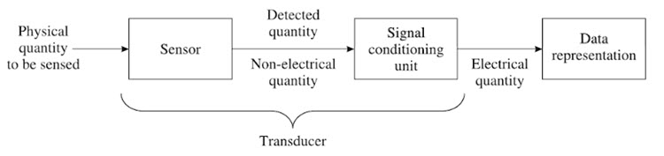
Sensor/Transducers
A Sensor is a device that is used to detect changes in any physical quantity like Temperature, Speed, Flow, Level, Pressure, etc. Any changes in the input quantity will be detected by a Sensor and reflected as changes in output quantity.
Both the input and output quantities of a Sensor are Physical i.e., non-electrical in nature.
Generally speaking, a Transducer is a device that converts one form of energy into another by the principle of Transduction. Usually, a signal in one form of energy is converted to a signal in another form by a Transducer.
From the above example, a Transducer is a device that converts a Physical Quantity into an Electrical Quantity.

Slide 9
Sensor is a device that detects and responds to a physical or chemical stimulus.
Examples of sensors include temperature sensors, pressure sensors, motion sensors, and pH sensors.
Transducer, on the other hand, is a device that converts one form of energy into another.
Examples of transducers include speakers, microphones, accelerometers, and actuators.

Slide 10
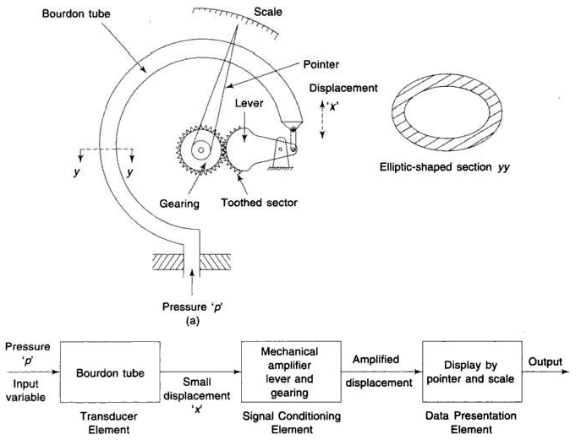
Example of Measurement System: Mechanical Application

Slide 11
Electrodynamic type Application: Displacement Measurement

Slide 12
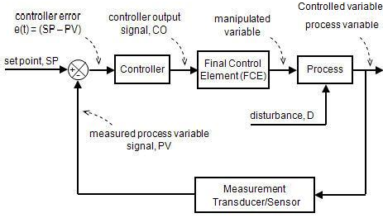
Automation: Automatic Control system:

Slide 13
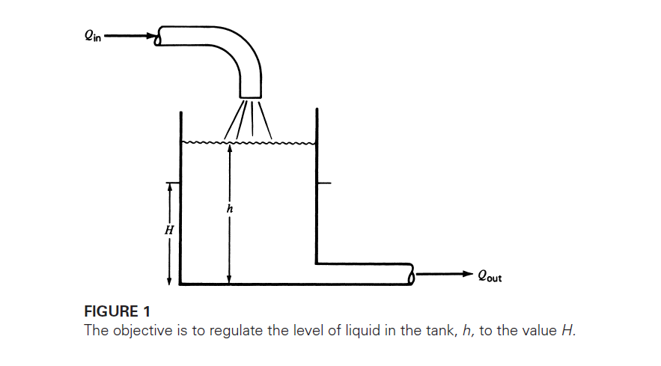
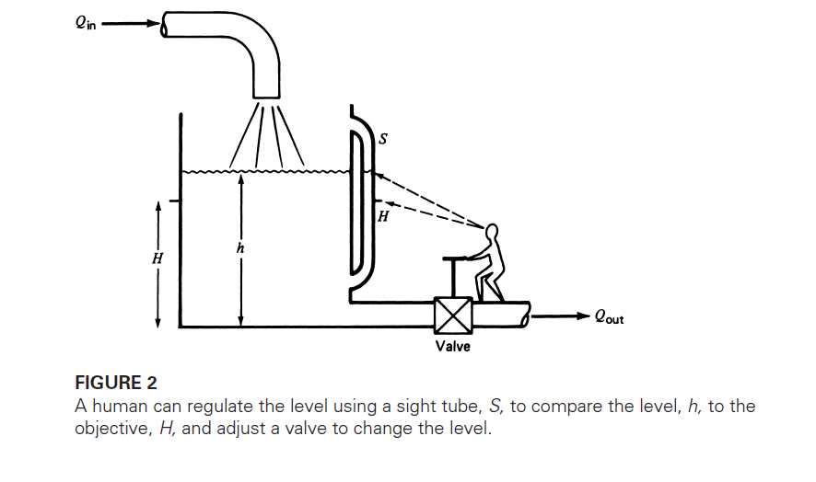
Why Automation ?: Example Level Measurement system
Example: 1 Manual Level control

Slide 14
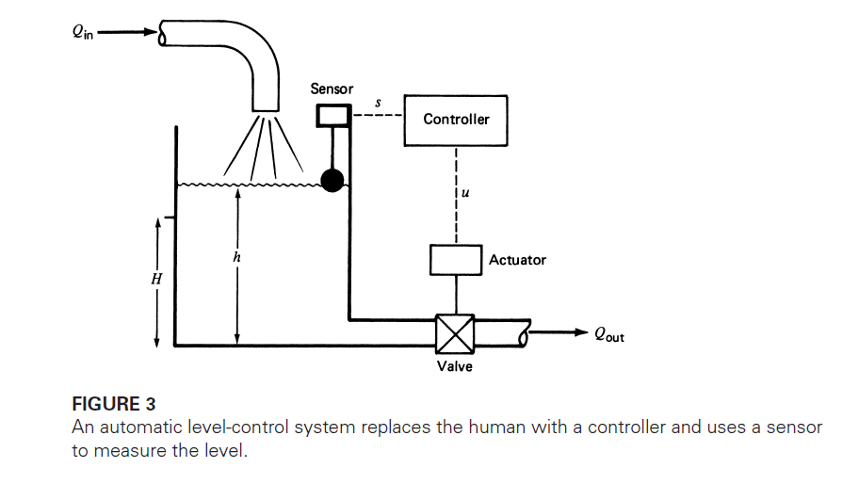
Example: 1 Automatic Level control

Slide 15
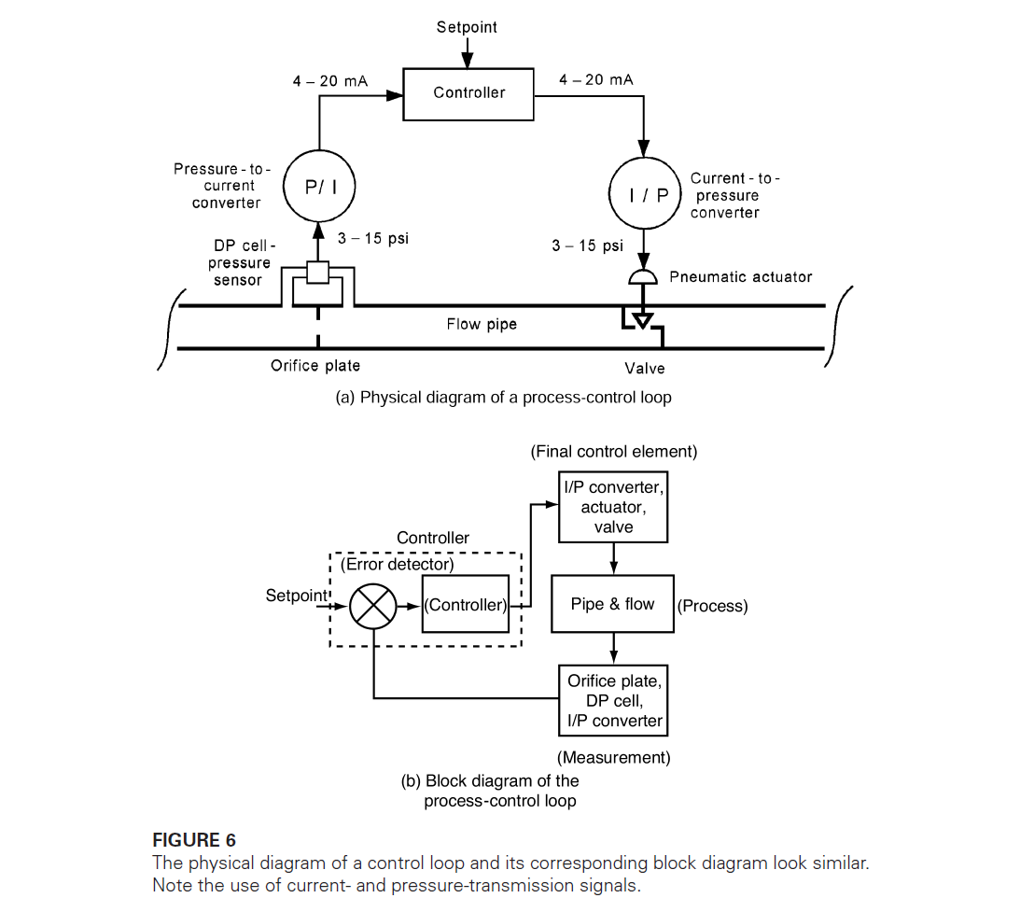
Example: 2 Automatic flow control

Slide 16
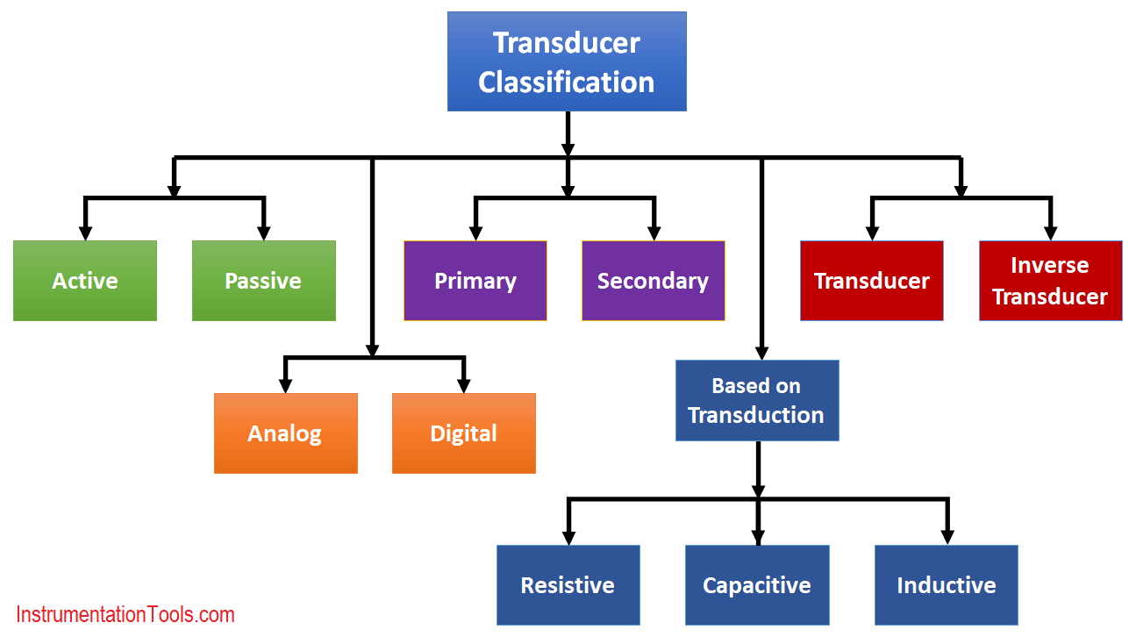
General classification of Transducers/Sensors

Slide 17
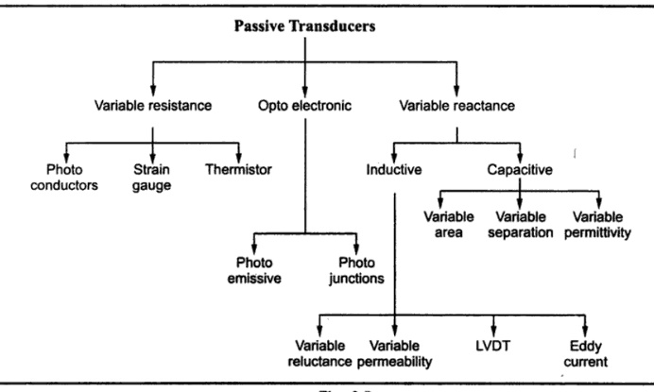

Slide 18
Types of Sensors and Applications
There are many different types of transducers, including:
Pressure transducers - These transducers convert pressure into an electrical signal, typically used in applications such as fluid measurement, automotive systems, and industrial control systems.
Temperature transducers - These transducers convert temperature into an electrical signal, and are used in applications such as HVAC systems, industrial process control, and food processing.

Slide 19
Accelerometer transducers - These transducers measure acceleration or vibration and are used in applications such as structural health monitoring, aerospace, and automotive systems.
Strain gauge transducers - These transducers measure changes in the strain of a material and are used in applications such as load cells, torque sensors, and pressure sensors.

Slide 20
Flow transducers - These transducers measure fluid flow and are used in applications such as chemical processing, water treatment, and food and beverage production.
Magnetic transducers - These transducers use magnetic fields to measure position, velocity, or distance, and are used in applications such as robotics, automotive systems, and industrial control systems.
Optical transducers - These transducers use light to measure position, velocity, or distance, and are used in applications such as laser measurement, spectroscopy, and imaging.

Slide 21
Ultrasonic transducers - These transducers use sound waves to measure distance, level, or flow, and are used in applications such as medical imaging, industrial testing, and underwater navigation.
Capacitive transducers - These transducers measure changes in capacitance and are used in applications such as touch screens, proximity sensors, and level sensors.
Piezoelectric transducers - These transducers convert mechanical energy into electrical energy and are used in applications such as medical imaging, sonar, and vibration sensing.

Slide 22
Light sensors - used to detect light levels in an environment.
Humidity sensors - used to measure the amount of moisture in the air or in a material.
Magnetic sensors - used to detect magnetic fields.
Flow sensors - used to measure the flow rate of fluids or gases.
Gas sensors - used to detect the presence of gases in the air.
pH sensors - used to measure the acidity or alkalinity of a substance.

Slide 23
Sound sensors - used to detect sound levels in an environment.
Image sensors - used to capture images or video.
Position sensors - used to measure the position or movement of an object.
Motion sensors - used to detect motion or movement.
Proximity sensors - used to detect the presence of an object without physical contact.

Slide 24
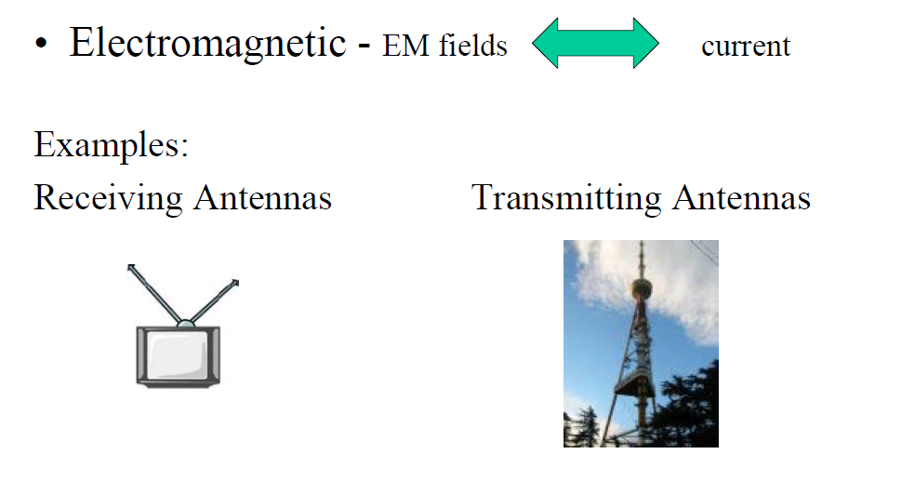
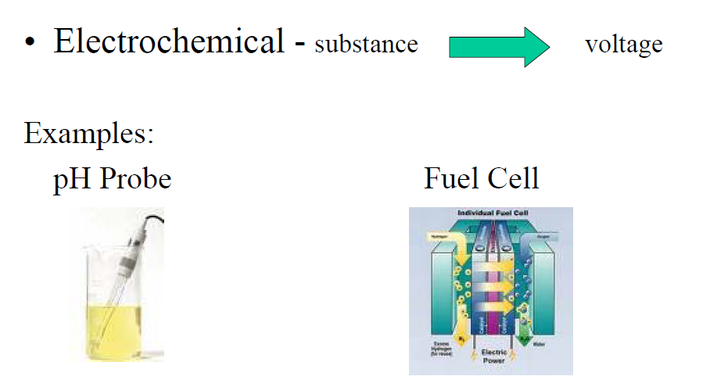
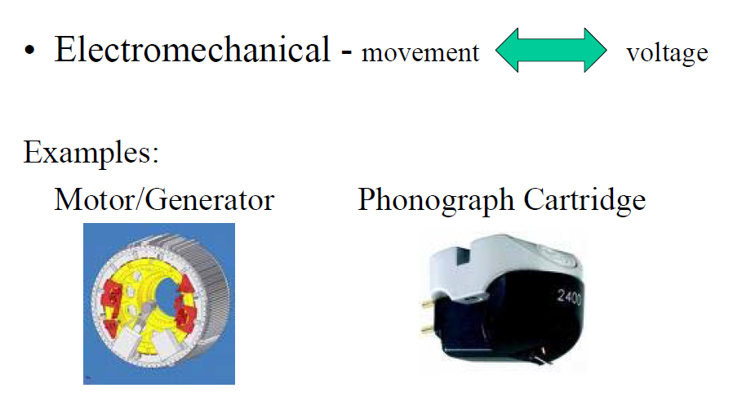
Transducers Classification: According to Application Area

Slide 25
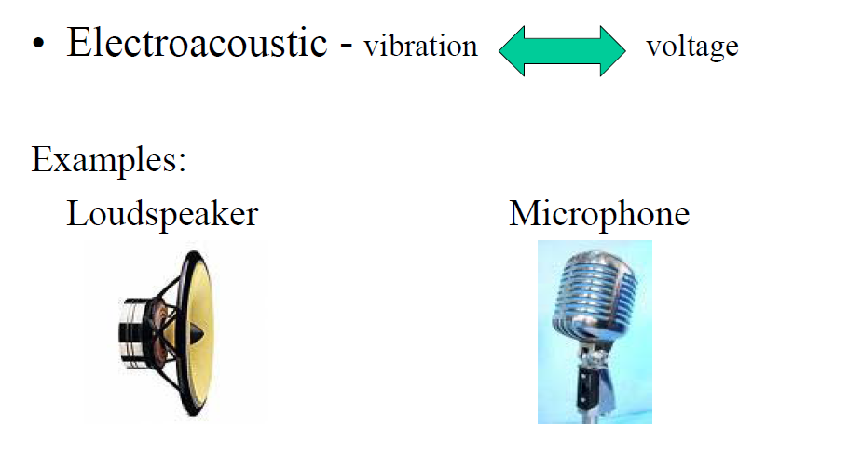
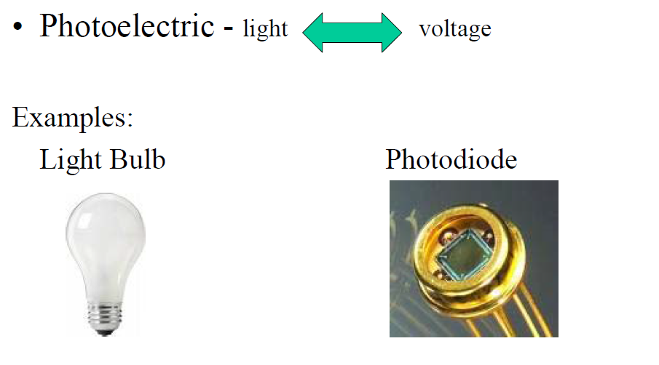
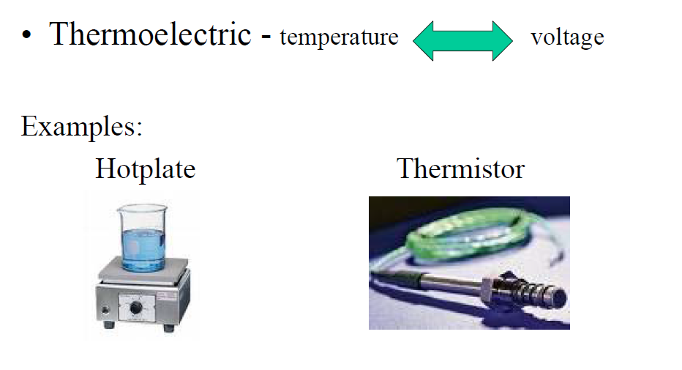

Slide 26
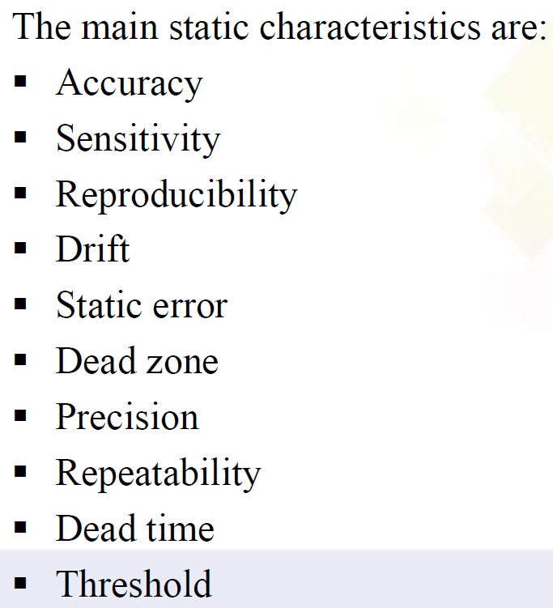
Transducer Characteristics :
1.Static 2.Dynamic
1.Static Characteristics

Slide 27
1.Accuracy
Accuracy is defined as the closeness of the transducer output to the true value of the measured quantity.
However, in usual practice, it is specified as the inaccuracy of measurement from the true value by calculating the absolute and percent error.
The accuracy of an instrument depends on the various systematic errors.

Slide 28
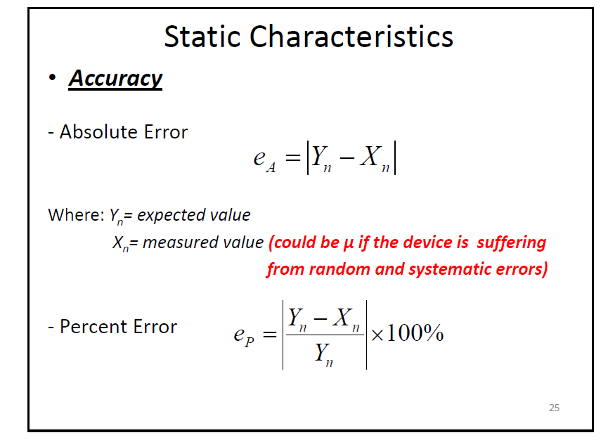

Slide 29
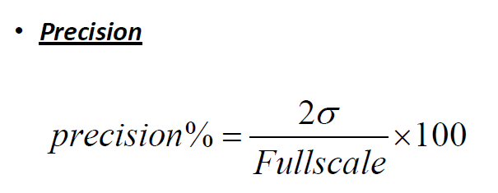
2.Precision is defined as the ability of the instrument to reproduce a certain set of readings within a given accuracy
3.Repeatability: It is defined as the ability of the instrument to reproduce a group of measurements of the same measured quantity, made by the same observer, using the same instrument, and under the same conditions

Slide 30
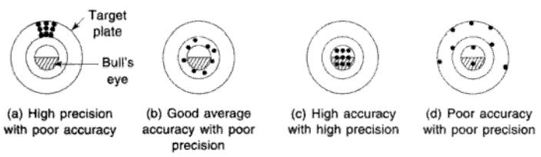
Accuracy vs. Precision
The precision of the instrument depends on the factors that cause random errors.

Slide 31
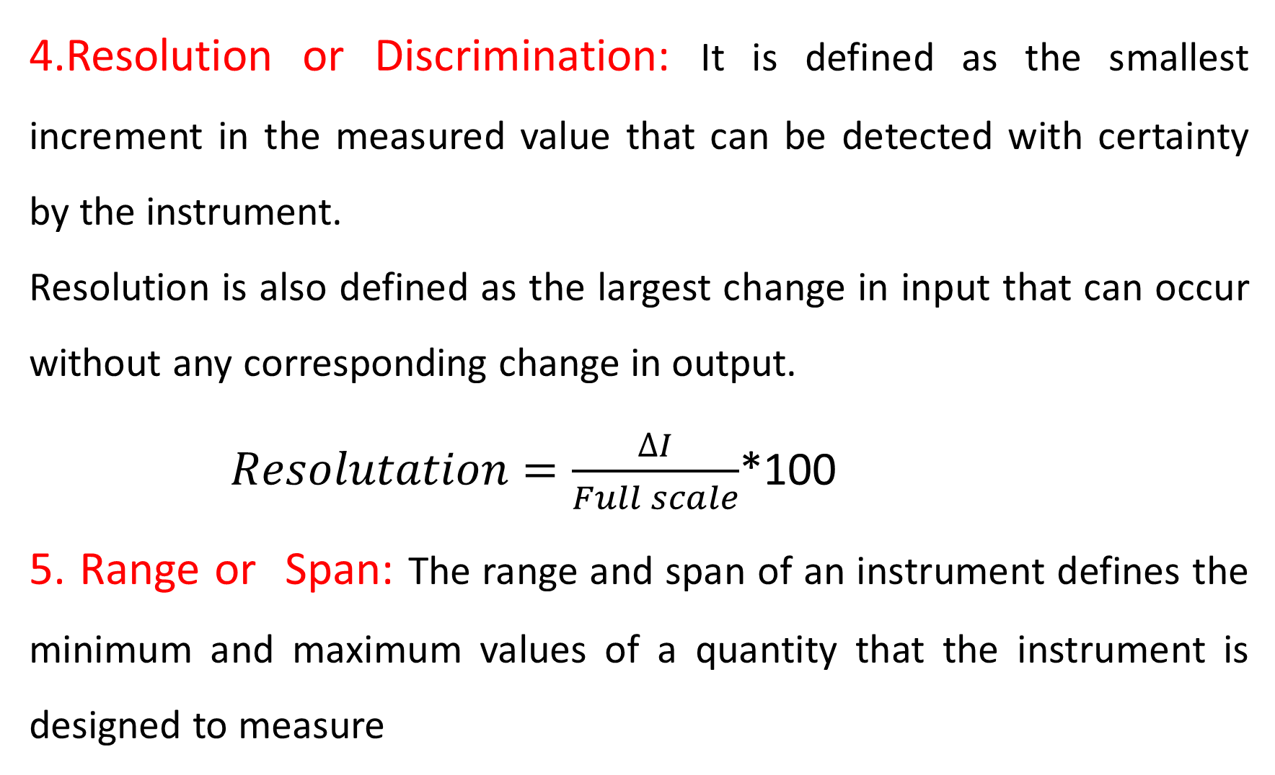
4.Resolution or Discrimination: It is defined as the smallest increment in the measured value that can be detected with certainty by the instrument.
Resolution is also defined as the largest change in input that can occur without any corresponding change in output.
$Resolutation=\frac{∆I}{Full scale}$*100
5. Range or Span: The range and span of an instrument defines the minimum and maximum values of a quantity that the instrument is designed to measure

Slide 32
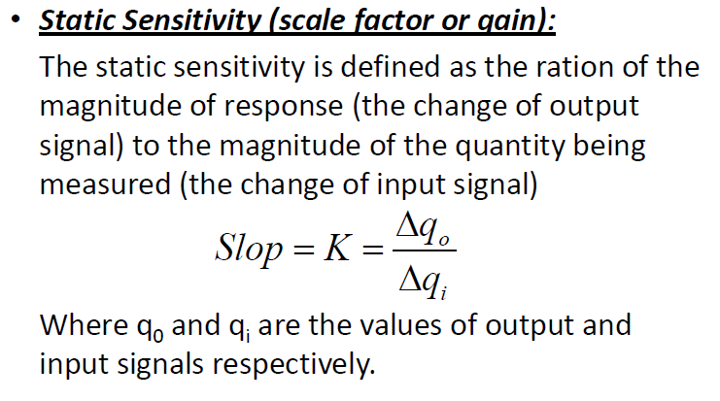

Slide 33
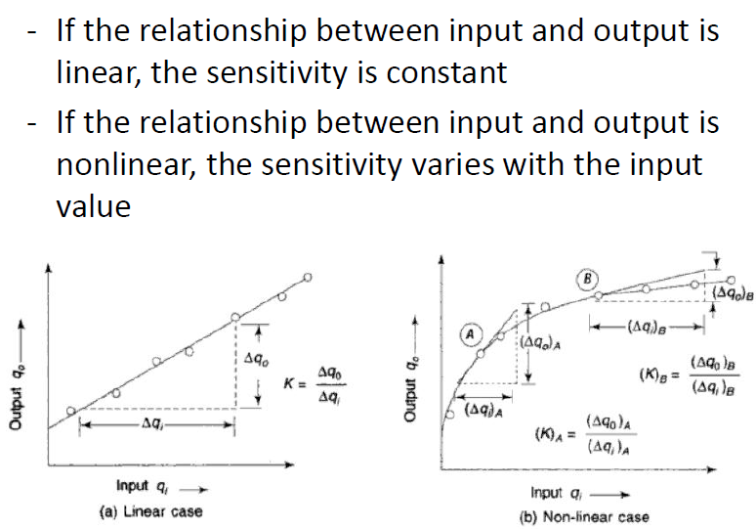

Slide 34
7.Linearity refers to the property of a system or function that exhibits a proportional relationship between its inputs and outputs.

Slide 36
8.Drift: The variation of output for a given input caused due to change in the sensitivity of the instrument due to certain interfering inputs like temperature changes.

Slide 37
9.Hysteresis refers to a phenomenon in which the value of a physical property of a system depends on its history.
Hysteresis loss is caused by the magnetization and demagnetization of the core as current flows in the forward and reverse directions. As the magnetizing force (current) increases, the magnetic flux increases.
Examples include backlash in gears caused by excess play, forces exerted by elastic materials, Schmitt triggers from electronic circuits, and magnetization of ferrous materials

Slide 38
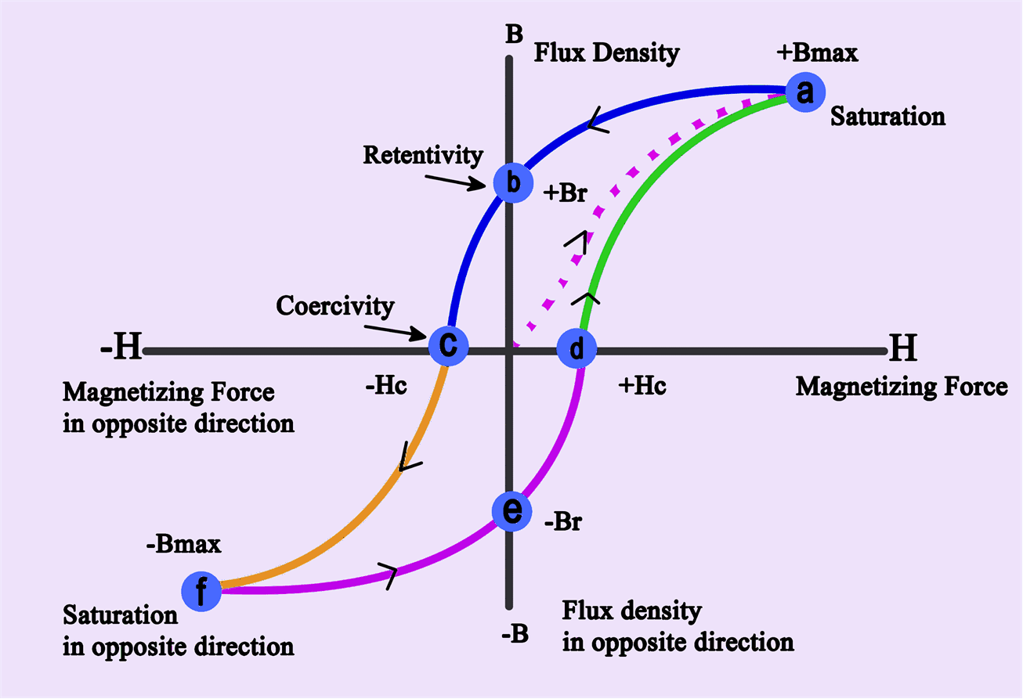

Slide 39
10.Dead Band: It is defined as the largest change of the measured to which the instrument does not respond
11.Backlash: It is defined as the maximum distance or angle through t which any part of the mechanical system may be moved in one direction causing motion of the next part.(It is similar to hysteresis loop)

Slide 40
12.Loading Effect(Impendence Load):
Any measuring instrument with an input signal source would extract some energy, thereby changing the value of measured variable.
This means that the input signal suffers a change by it is being measured this is called as loading
Major problem in analog signal conditioning is loading of one circuit by another. Circuit
The loading effect cannot zero. But it can be minimized’

Slide 41
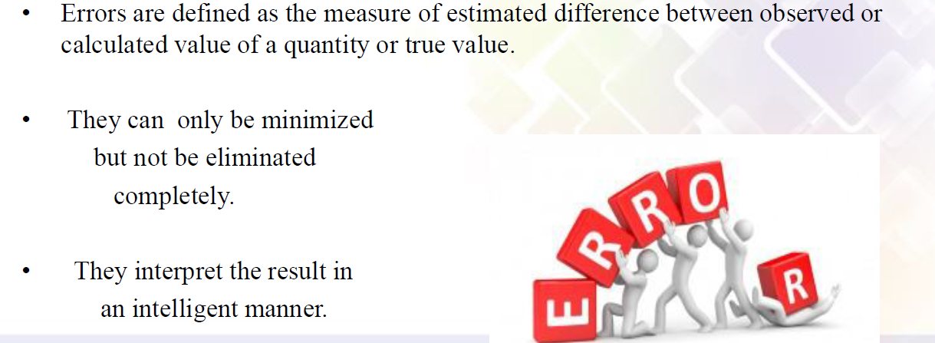
13.Errors

Slide 42
Type of Errors
Systematic errors: Errors that tend to have the same magnitude and sign for the given set of conditions, such as instrument, environmental, and loading errors. This type of error can be eliminated by applying the proper calibration.
Random (or Accidental) errors): These errors are of variable magnitude and sign and do not obey any known law. Theses errors caused due to random variation in the parameter or the system of measurement, such as the accuracy of measuring small quantities. This type of error can be calculated by using statistical analysis.

Slide 43
Gross errors:
These are generally the fault of the person using the instruments, and are due to:
Incorrect reading of instruments .
Incorrect recording of experiment data..
Incorrect use of instruments.
These errors may be of any magnitude and cannot be subjected to mathematical treatment.

Slide 44
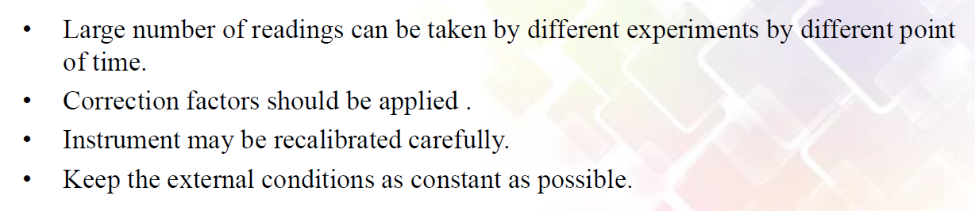
Remedies to Minimize Errors

Slide 45
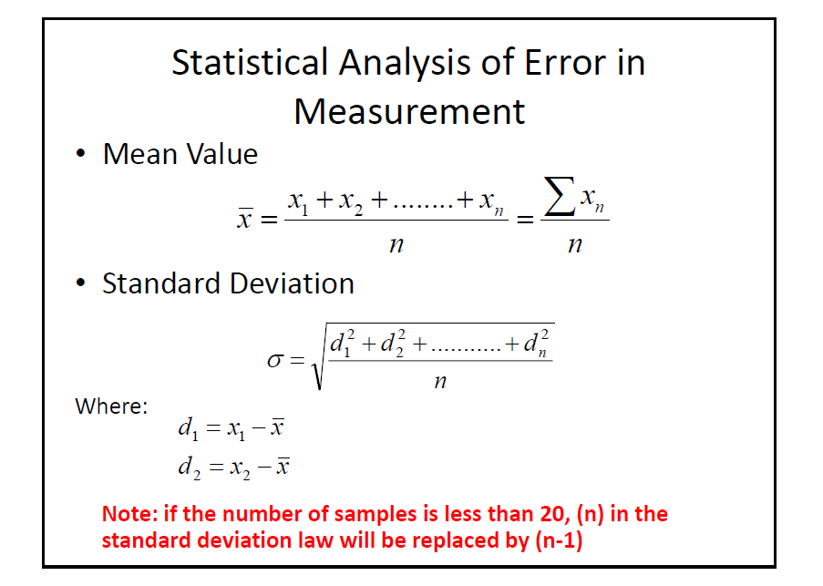

Slide 47
Statistical Analysis of Error in Measurement
Interpretation of Standard deviation
If the error is truly random and we have large sample of readings, the data and the standard deviation is related to the normal probability curve.
The normal probability curve has the following characteristics:
68% of readings lie within ±1σ of the mean
95.5% of readings lie within ±2σ of the mean
99.7% of readings lie within ±3σ of the mean

Slide 48
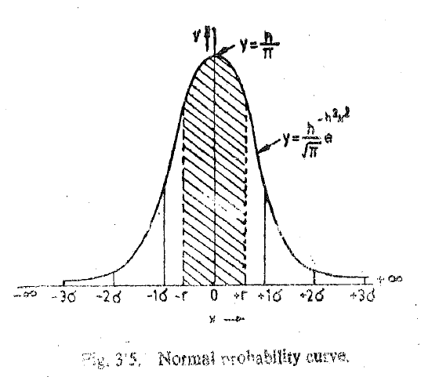

Slide 49
Example 1:
The temperature measured in eight locations in a room and the the values obtained were 21.2℃, 25.0 ℃,18.5 ℃,19.5 ℃,27.1 ℃,19.0 ℃ and 20.0. ℃ 18.5 ℃ Find
1. Arithmetic Mean
2. Standard Deviation

Slide 50
Example 2:
The following 10 observations were recorded when measuring a voltage 41.7, 42.0 ,41.8 ,42.0, 42.1,41.9, 42.5,42.0, 41.9 and 41.8
Find
Arithmetic Mean(A:41.97)
Standard deviation(A:0.221)
Probable error of one reading(Self A: 0.047 (Correct))
Range() : Range = 42.5 - 41.7 = 0.8

Slide 51
Example 3:
In a test temp. is measured100 times with various instruments and procedure and following observations made
Find
Arithmetic Mean(400.78) 2.Average deviation(1.048)3.Standard Deviation(1.38),4. Variance 5. Probable error(0.43)
Temp. ℃ | 397 | 398 | 399 | 400 | 401 | 402 | 403 | 404 | 405
Frequency | 1 | 3 | 12 | 23 | 37 | 16 | 4 | 2 | 2

Slide 52
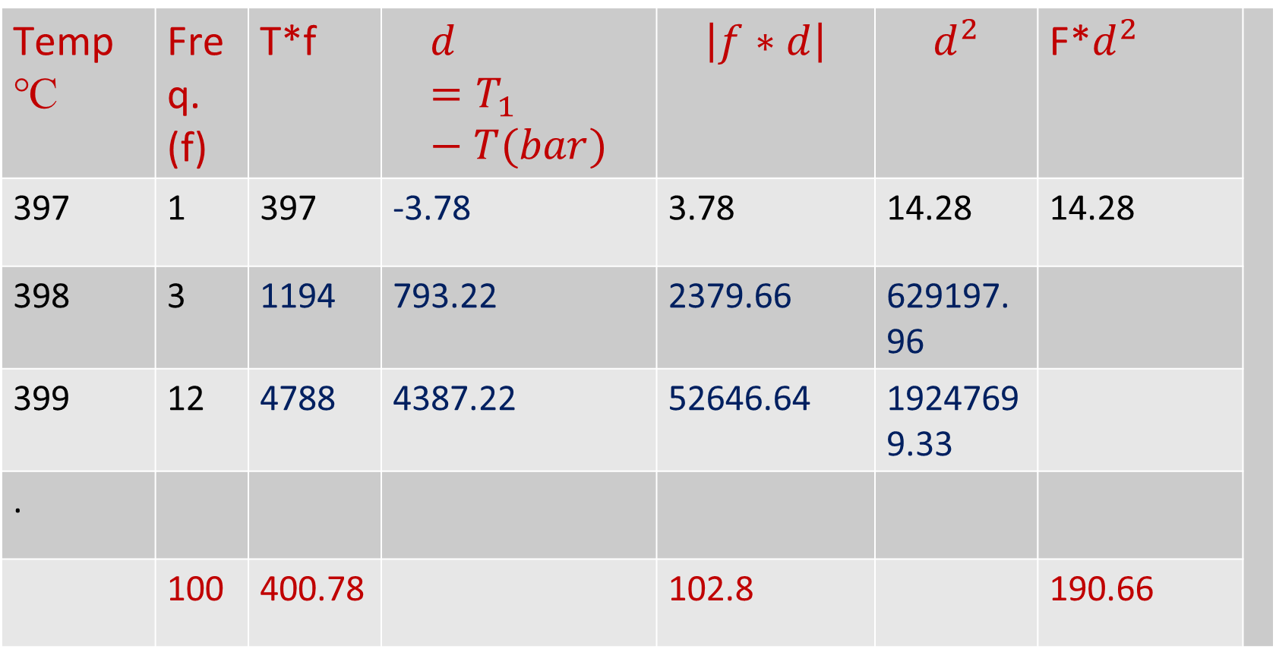
Sample calculations
Temp ℃ | Freq. (f) | T*f | $$d=T_{1}−T(bar)$$ | $$\left|f∗d\right|$$ | $$d^{2}$$ | F*$d^{2}$
397 | 1 | 397 | -3.78 | 3.78 | 14.28 | 14.28
398 | 3 | 1194 | 793.22 | 2379.66 | 629197.96
399 | 12 | 4788 | 4387.22 | 52646.64 | 19247699.33
.
 | 100 | 400.78 |  | 102.8 |  | 190.66

Slide 53
Example 4:
In a test temp. is measured100 times with various instruments and procedure and following observations made
Find:,
Arithmetic Mean(99.98℃) 2.Average deviation(0.5196℃)3.Standard Deviation(0.67℃)
4. Variance(0.46℃) 5. Probable error(0.4626℃)
Temp.℃ | 98.5 | 99 | 99.5 | 100 | 100.5 | 101.0 | 101.5
Frequency | 4 | 13 | 19 | 35 | 17 | 10 | 02

Slide 54
Dynamic characteristics
The dynamic characteristics of a transducer refer to how the transducer responds to changes in the input signal over time.
Frequency response: This refers to the range of frequencies that the transducer can accurately measure. A transducer with a wider frequency response will be able to measure a broader range of signals.
Rise time: This is the time it takes for the transducer's output to reach a specified percentage of its final value in response to a step change in the input signal. A faster rise time indicates a more responsive transducer.

Slide 55
3.Overshoot and settling time: Overshoot refers to the amount by which the transducer's output exceeds its final value before settling down.
4. Settling time is the time it takes for the output to settle within a specified range of the final value.
A transducer with low overshoot and settling time will produce more accurate and stable measurements.
5.Hysteresis: This refers to the tendency of the transducer's output to lag behind changes in the input signal. Hysteresis can cause measurement errors and can be minimized through careful calibration and design of the transducer.
5.Non-linearity: This refers to the deviation of the transducer's output from a linear relationship with the input signal.

Slide 56
Input Signals in Dynamic Systems

Slide 57
Input Signals in Dynamic Systems

Slide 58
Dynamic Characteristics of Zero order system:
Potentiometer

Slide 59
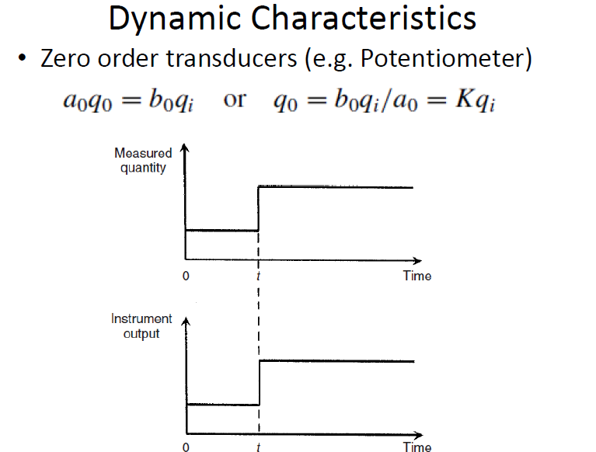

Slide 60
Dynamic Characteristics of First order system
( Thermocouple )

Slide 61
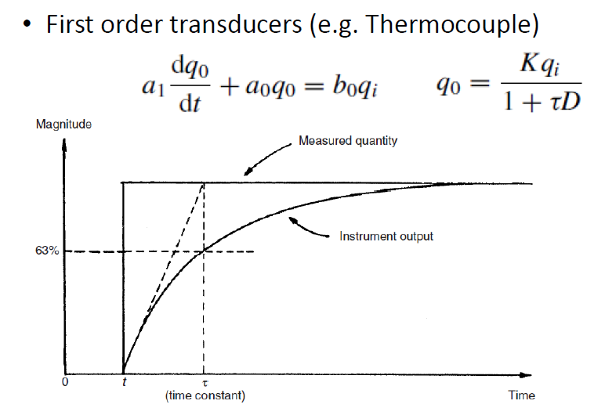

Slide 62
Dynamic Characteristics of Second order system

Slide 63
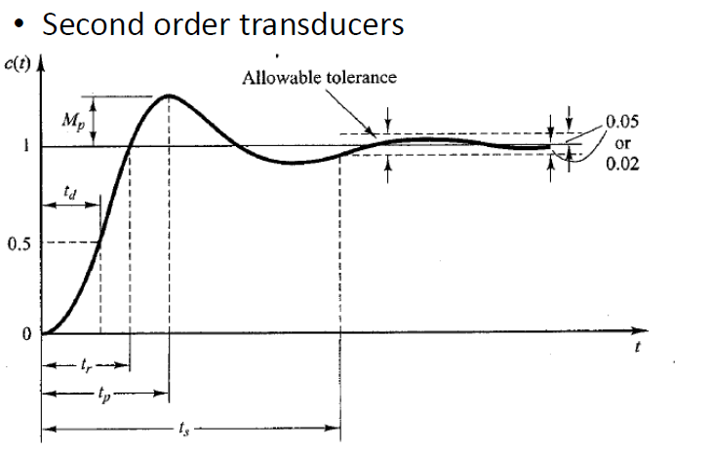
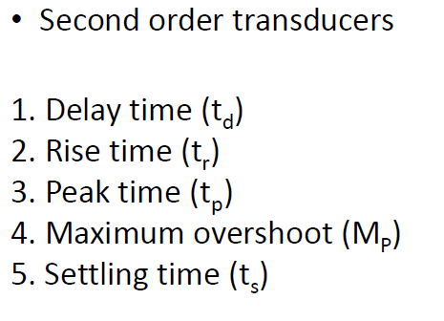

Slide 64
Selecting of a transducer:
Type of energy: Determine the type of energy that needs to be measured or converted, such as electrical, mechanical, thermal, or optical.
Sensitivity: The sensitivity of a transducer is the minimum amount of energy that it can detect or convert. The sensitivity required depends on the precision needed for the application.
Range: The range of a transducer is the minimum and maximum values that it can measure or convert..

Slide 65
4.Accuracy: The accuracy of a transducer is the degree of closeness between the measured or converted value and the true value.
5.Response time: The response time of a transducer is the time it takes to detect or convert energy. The response time required depends on the speed at which the energy is changing.
6.Environment: Consider the environment in which the transducer will be used, including temperature, humidity, pressure, and vibration.
7.The cost of a transducer can vary significantly depending on its features and specifications

Slide 66
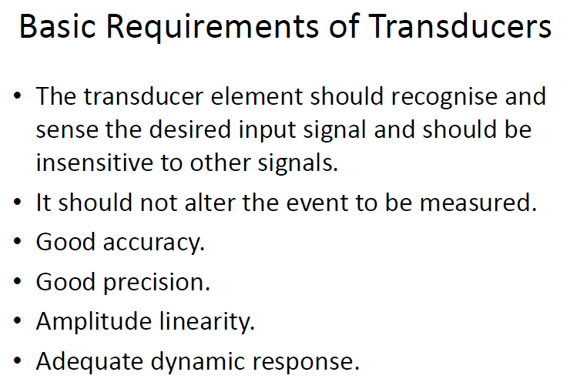
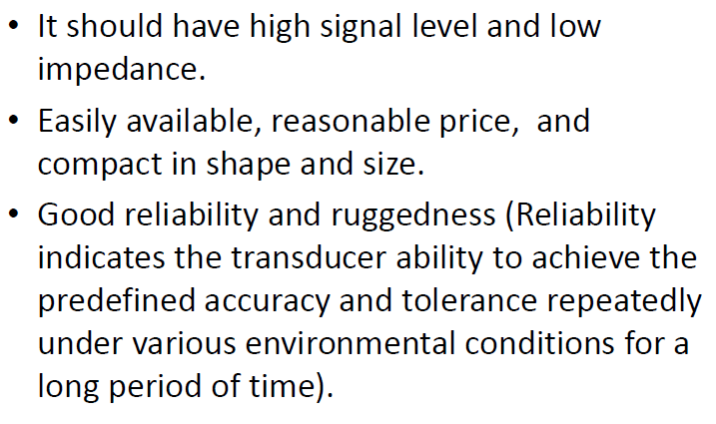

Slide 67
THANK YOU

